Slide 1




How to manage a coding project?
Multivariate Statistics class
October 2025

Slide 2
Basic principles of git
Files are stored online (https://github.com/)
You download them locally using git (git pull command)
You modify them, create some, delete some…
When you are done you push your changes online (git push)
Next time your partners are coding, they will first do a git pull to refresh the codes with your modifications

Slide 3
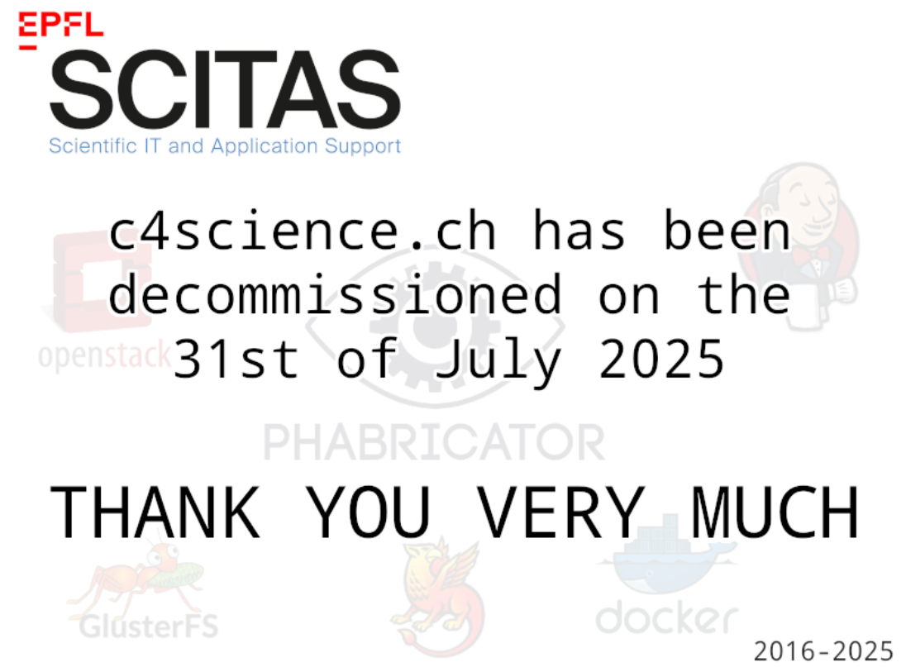
Create the project
c4 science is dead so you need to use github (your own account) or gitlab.epfl.ch (your GASPAR account)
Examples provided here are with github but gitlab should work the same way

Slide 4
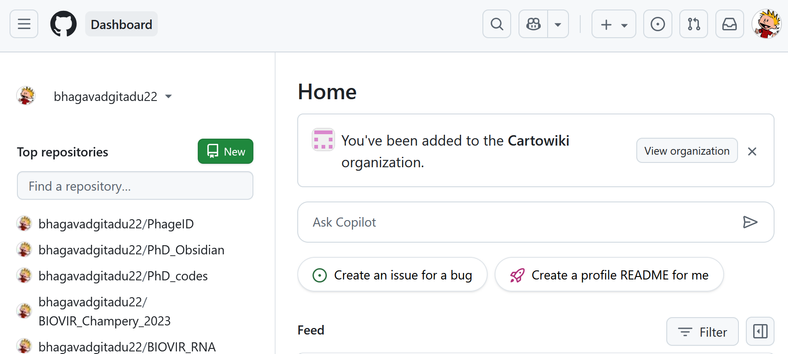
Create the project
Create an account on github.com
Create a new repository

Slide 5
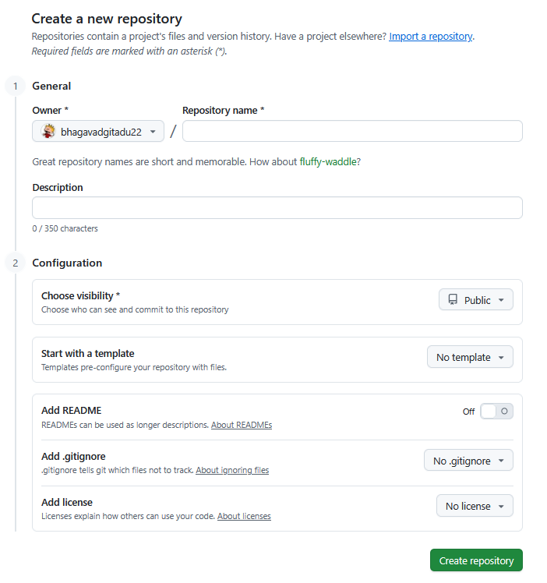
Create the project
Name it and create it
You can put it in private but then you need to add your team members in the collaborators of the project later

Slide 6
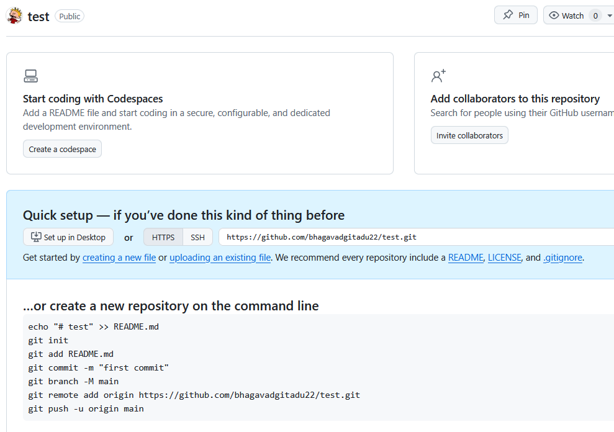
Create the project
Now your project exists online!
You can invite collaborators

Slide 7
Get the project on your computer
First download and install git
  https://git-scm.com/downloads
Go to the directory where you want to work
Open a terminal command from there
Then you can download the project from online:
git clone https://github.com/<username>/<repository_name>
Now you have the a new directory named repository_name

Slide 8
Do your coding!
You can do whatever in repository_name:
  Modify, create, delete files…
You can use any editor you like on your computer:
  Rstudio, Visual Studio, JupyterLab…
Or even directly work on your EPFL noto server
  https://noto.epfl.ch
But what you do is only local!
At some point you need to send it online to update the github

Slide 9
Update the github for your team
Git uses three important operations that every one needs to know:
add: adds new/changed files to a commit
commit: finalizes the commit locally, storing it in the local repository (on the user's computer)
push: copies the commits from the local repository to the remote repository

Slide 10
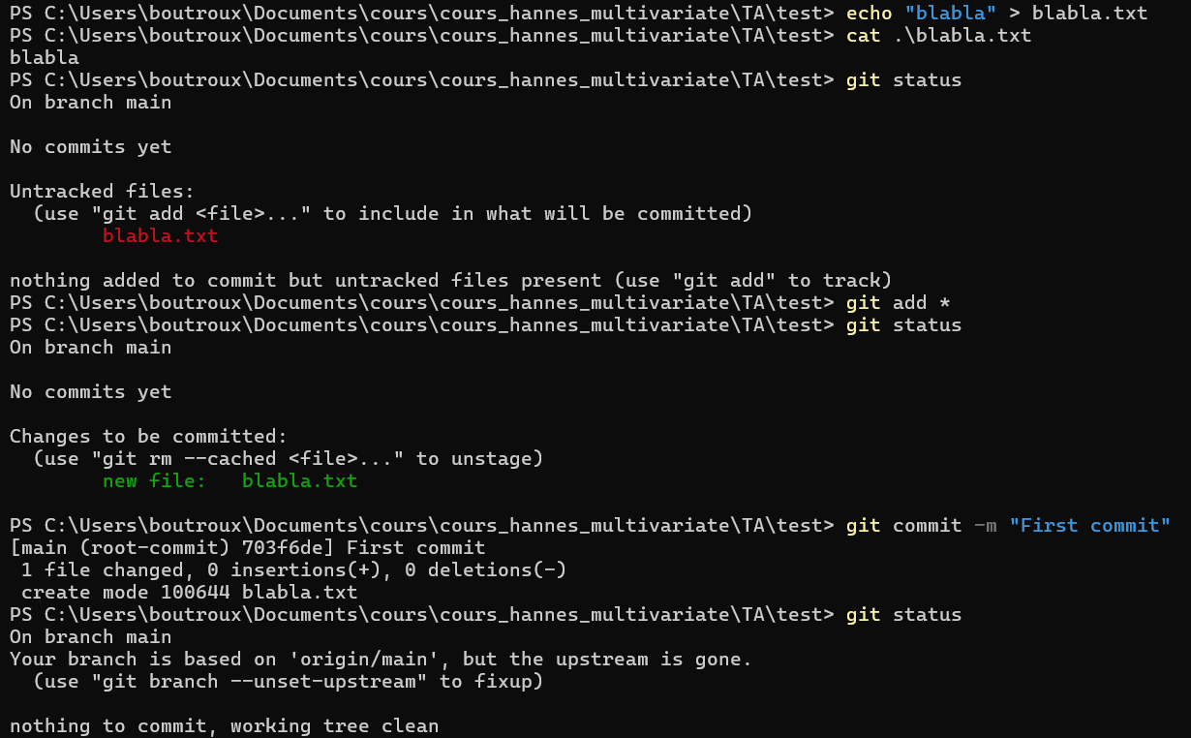
Example of commit

Slide 11
The push command: git push origin main
The first part is the name of your remote (it directs to your github repository): by default it is origin
The second part is the branch you want to push
Branches allows to work on alternate versions of the project
By default there is only one branch named main on github
-> If you keep the basic configuration «git push origin main» will work

Slide 12
Git may ask for authentication for push
It will not accept your github/gitlab passwork
Instead it wants a Personal Access Token (PAT)
You generate it directly on your account
  Go to Settings -> Developer settings
  Then Personal access tokens -> Tokens (classic)
  Then click on «Generate new token»
You will get a token like:
  ghp_UioSWcHADZr8893LfpfjLegchu849r1FU89
Save it preciously you will need it to update any of your git projects!

Slide 13
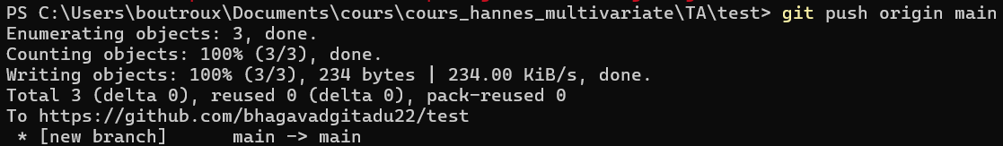
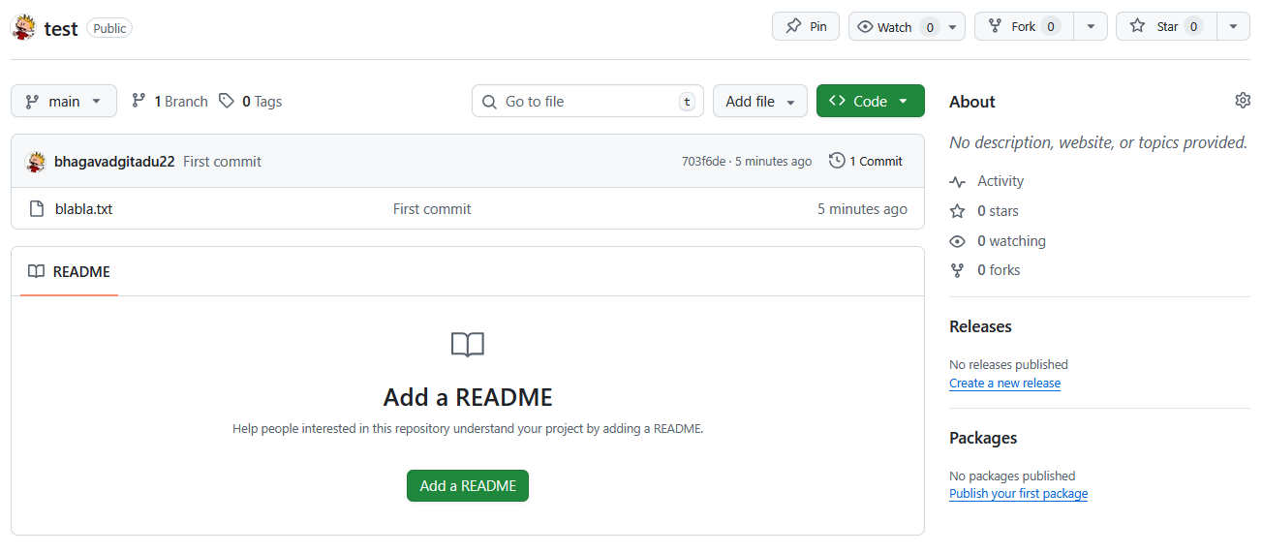
Example of push
Magic! blabla is now online

Slide 14
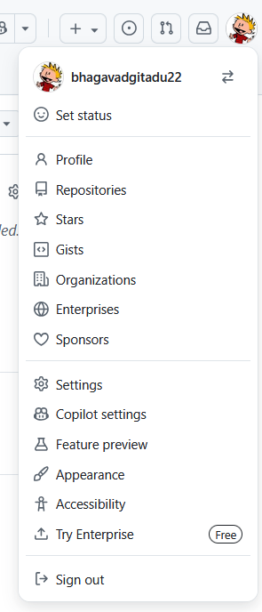
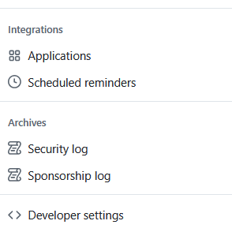
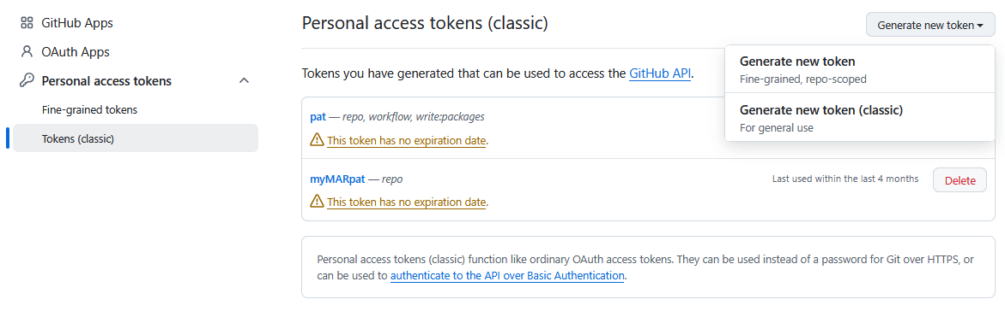
Example of generation of a PAT (github)

Slide 15
Get the changes made by the rest of your team
Last crucial git command:
pull: recovers latest version of the github repository
Same logic as git push
“git pull origin main” will work fine for the default configuration

Slide 16
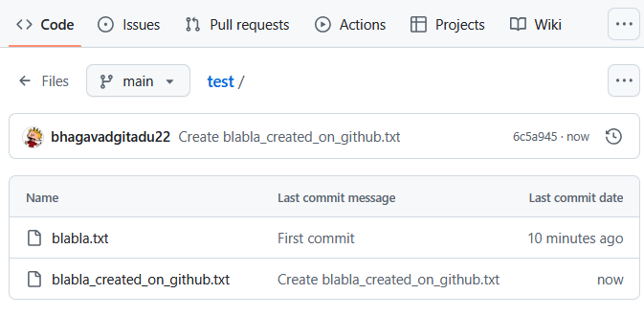
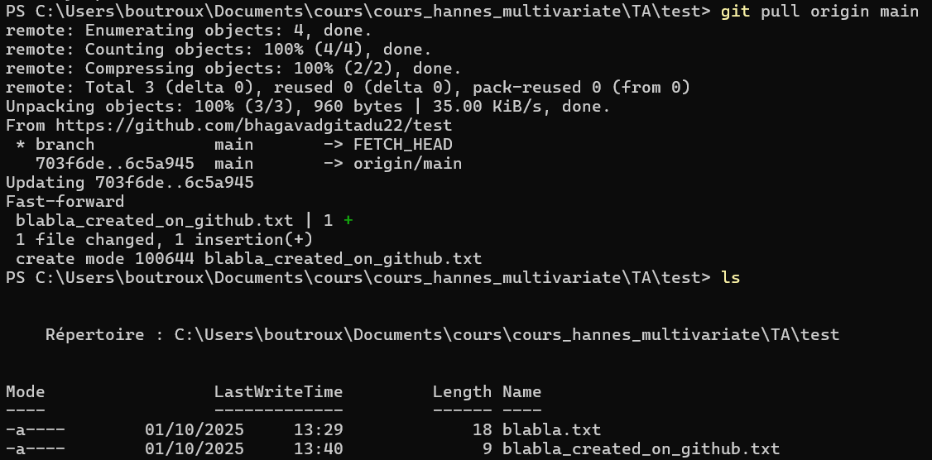
Example of pull
Magic! You got the new github file blabla_created_on_github locally

Slide 17
Beware of push/pull conflicts!
2 versions of the same file can exist when pushing or pulling
For instance you modified blabla and want to push it online but another coder also modified blabla and have put a new version online in the meantime
Conflict problem: which version of blabla keep?
-> Git will try to solve it itself and if it cannot it will ask you to decide which lines you wanna keep from each version of the file
Try to avoid this situation if you wanna keep it simple
-> Talk to each other to manage your github well!

Slide 18
Further info on git
EPFL tutorial: https://wiki.epfl.ch/git-epfl/documents/git.html
Git basics: https://git-scm.com/book/en/v2/Git-Basics-Getting-a-Git-Repository

Slide 19
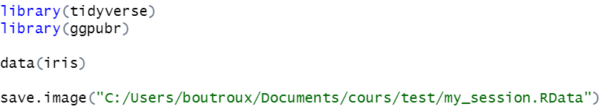

How to share your packages and variables?
Save your packages and data in a .Rdata file that you add on github
Team members can load the file later on with
Just adjust the paths to your own my_session.Rdata file

Slide 20
How to work on your github files via noto?
You do not need to download an editor on your computer
Instead you can work directly on your noto server
You work on the git of noto exactly like on the git on your computer
You do not need to commit every time you end your coding: your changes will be saved locally on your noto server until you push them on github

Slide 21
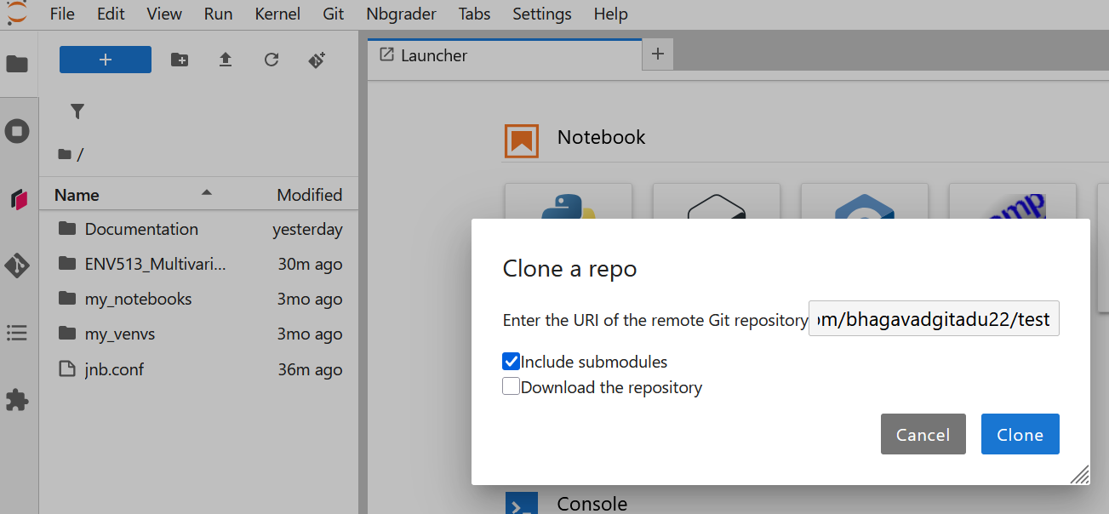
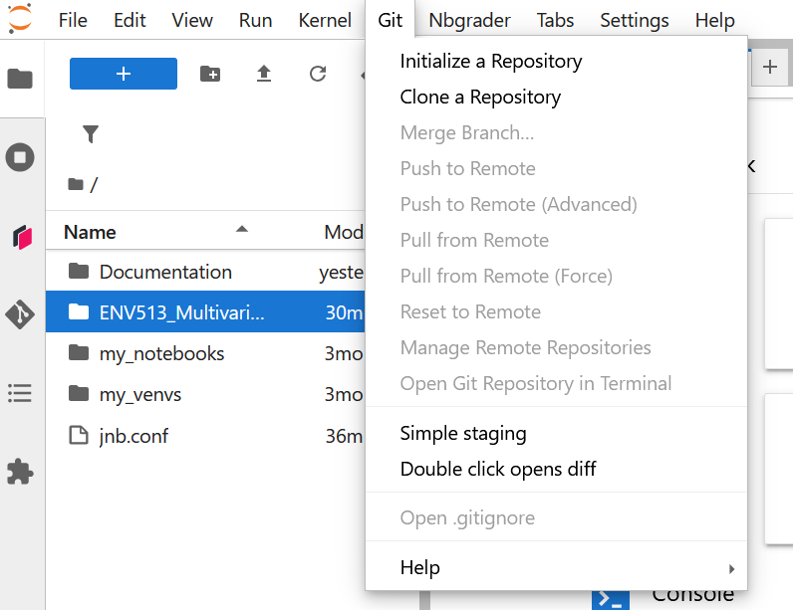
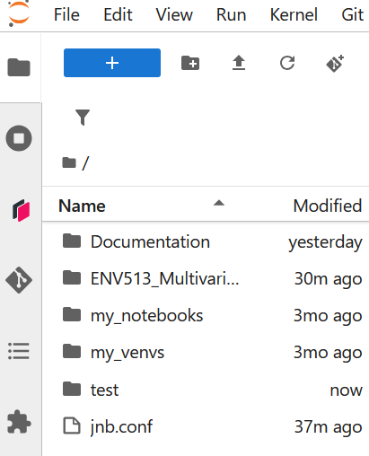
Import your repository
Adapt the address to your git: for me https://github.com/bhagavadgitadu22/test

Slide 22
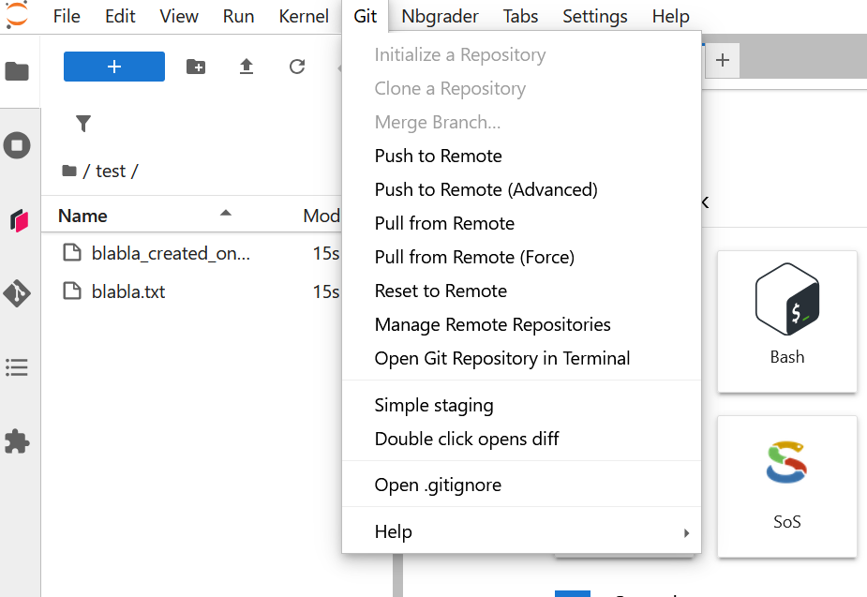
The rest happens via the terminal
You can do all your modifications
When you are done commit and push your changes via the git terminal

Slide 23
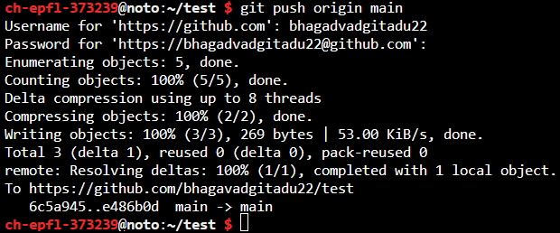
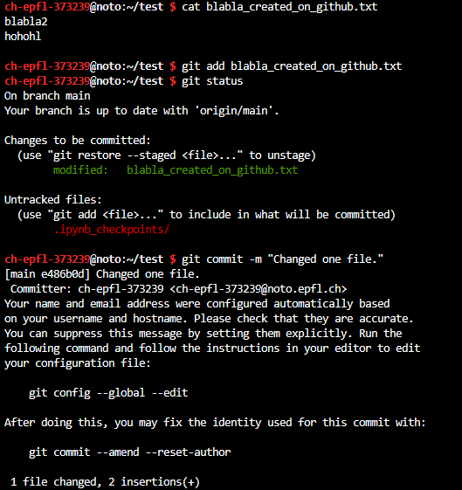
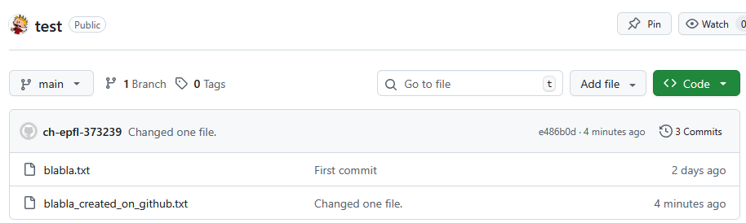
Push your changes on github
blabla_created_on_github.txt has indeed been updated on github!

Slide 24
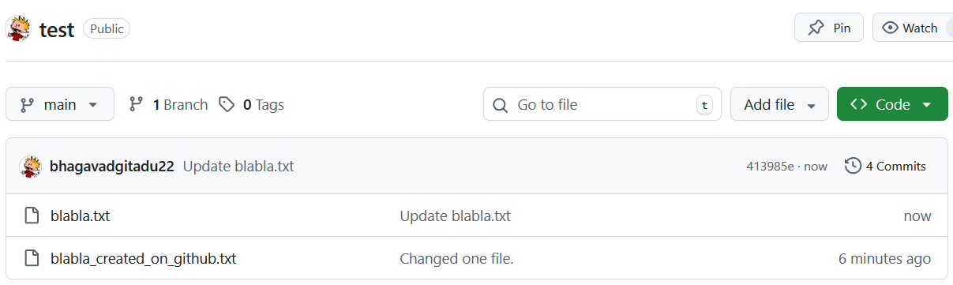
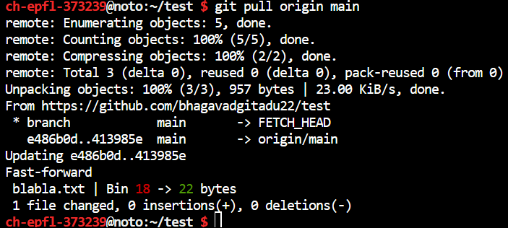
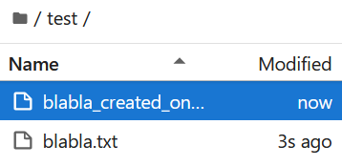
Pull new changes from github
blabla.txt has been updated by someone on github!
So you do a pull on noto to get the updates from github

